Slide 1






|| Jai Sri Gurudev||
ADICHUNCHANAGIRI UNIVERSITY
FACULTY OF ENGINEERING,MANAGEMENT AND TECHNOLOGY
(BGS INSTITUTE OF TECHNOLOGY, BG NAGAR, MANDYA)
MENTAL HEALTH TRACKER WITH DAILY CHECK -INS
HEALTH HACKERS
VINUTHA M
SONU P GOWDA
YASHASWINI HR
VARSHA BY
DATE: 11/04/2025 to 12/04/2025

Slide 2
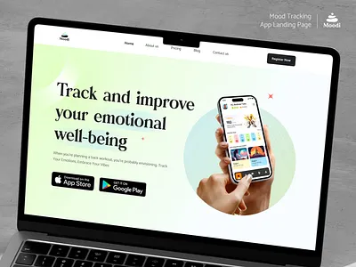
introduction
Mental health trackers are tools designed to help individuals monitor their emotional well-being.
They facilitate daily check-ins, allowing users to assess their mood and mental state regularly.
By using these trackers, individuals can identify patterns and triggers in their mental health over time.

Slide 3

PROBLEM STATEMENT
Over 1 in 4 individuals globally experience mental health issues each year.
Mental health often goes neglected due to stigma, lack of tools, or time constraints.
Daily reflection and tracking can help identify emotional patterns early, leading to better self-awareness and timely support.
Existing tools are often clinical, complex, or lack daily engagement features.

Slide 4
Solution overview
CHALLENGES People often ignore their mental well-being until its too late Mental health apps can feel overwhelming or clinical Lack of motivation to track consistently People may struggle to express emotions Insights are often too generic | OUR SOLUTIONS Daily mood check-ins with gentle reminders to build awareness Simple , friendly UI designed to feel like a personal space , not a medical tool Gamified experience with streaks, badges and encouragement messages Mood sliders , emoji-based trackers , and quick journaling prompts Personalized analytics and trend based on user behaviour

Slide 5
[user opens app] | ^ [daily mood check-in prompt] | ^ [user selects mood (emoji\slider)] | ^ [optional journal entry or activity log] | ^ [data stored securely] | ^ [insights generated (graphs/trends)] | ^ [motivational feedback or tip of the day] | ^ [streaks\badges updated] | ^ [user close the app]
FLOWCHART

Slide 6
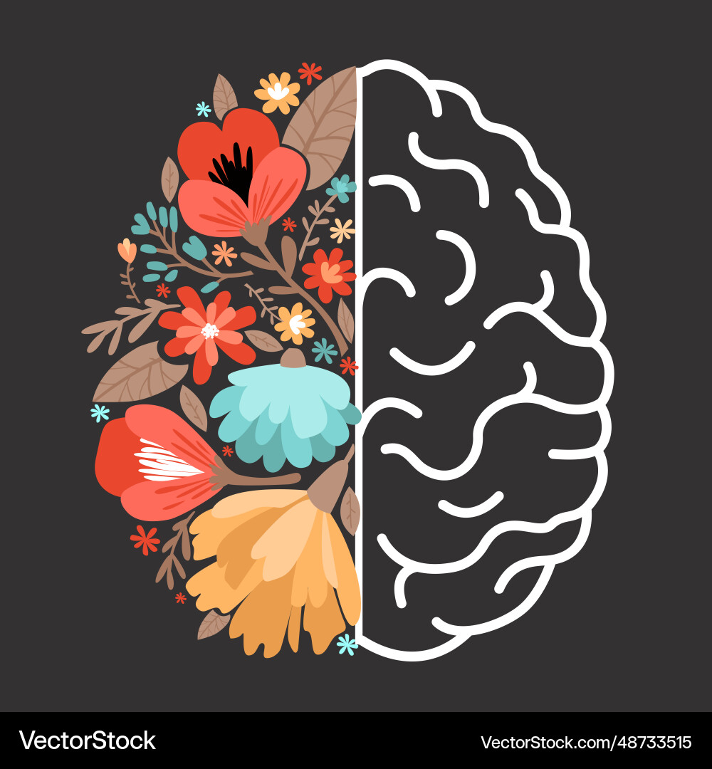
FEATURES
An effective tracker should include customizable mood scales for accurate self-assessment
Users benefit from journaling options that promote deeper reflection on their experiences.
Integration with reminders ensures consistency in daily check-ins, enhancing user engagement

Slide 7

TARGET AUDIENCE
Students managing academic pressure and life transitions.
Professionals dealing with burnout, remote work isolation, or stress.
Individuals in need of emotional awareness but not clinical therapy.
Anyone seeking a low-barrier, private way to reflect on their feelings.
MindMate is designed for inclusivity, minimal effort, and maximum emotional impact.

Slide 8

IMPACTS AND BENEFITS
Promotes self-awareness and encourages emotional check-ins.
Helps identify recurring stressors or triggers.
Builds emotional vocabulary and expression skills over time.
Empowers users to take proactive steps in their mental health journey.
Non-clinical entry point for mental health support, bridging gaps in awareness.

Slide 9

FUTURE SCOPE
AI-generated daily check-in prompts based on user patterns.
Integration with smartwatches or health tracking devices.
Weekly mental wellness summaries and mood predictions.
Gamification (badges, streaks) to promote daily engagement.
Optional therapist integration or anonymous peer chatrooms.

Slide 10
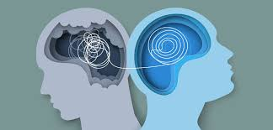
CONCLUSION
In conclusion, a mental health tracker with daily check-ins serves as a valuable tool for promoting emotional well-being and self-awareness. By encouraging consistent reflection on mental health, it empowers individuals to identify patterns, triggers, and progress over time. Regular check-ins provide a proactive approach to managing mental health, fostering mindfulness, and reducing the risk of neglecting emotional needs. Ultimately, this practice can lead to healthier coping mechanisms, a better understanding of one's mental state, and improved overall emotional resilience.

Slide 11


